Slide 1


JOHN AKINWANDE ELEWA
FEBRUARY 25, 2024

Slide 2

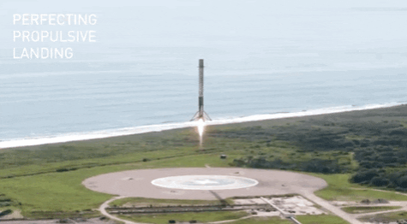
Outline
Executive Summary
Introduction
Methodology
Results
Conclusion
Appendix

Slide 3
Executive Summary
Summary of Methodologies
Summary of Results
Data Collection through API
Data Collection – Web Scrapping
Data Collection - Data Wrangling
Exploratory Data Analysis with SQL
Exploratory Data Analysis with Data Visualization
Interactive Visual Analytics with Folium
Machine Learning Prediction
Exploratory Data Analysis Results
Interactive Analytics
Predictive Analytics Results
Conclusion

Slide 4
Introduction
Project Background and Context
Problems to find Address
The SpaceX Data Science Project aims to leverage data analytics and machine learning techniques to enhance space exploration and rocket technology. As SpaceX continues to revolutionize space travel, understanding and optimizing data-driven processes become critical. This project operates at the intersection of data science, engineering, and space exploration.
Rocket Performance Optimization
Predictive Maintenance
Mission Success Rate Enhancement
Space Debris Mitigation
Improving on Crew Health and Safety
Potential for Increased Market Share

Slide 5

Section 1

Slide 6
Methodology
Executive Summary
Data collection methodology:
Data was collected via REST API with Web Scraping Methodology via Wikipedia
Performed data wrangling:
Data was cleaned, Missing values addressed, Categorized with One-hot-Encoding
Performed exploratory data analysis (EDA) using visualization and SQL
Performed interactive visual analytics using Folium and Plotly Dash
Performed predictive analysis using classification models:
Used to build, tune, evaluate classification models

Slide 7
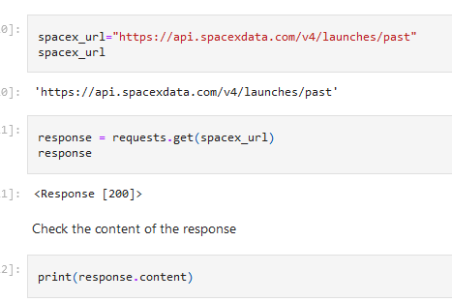
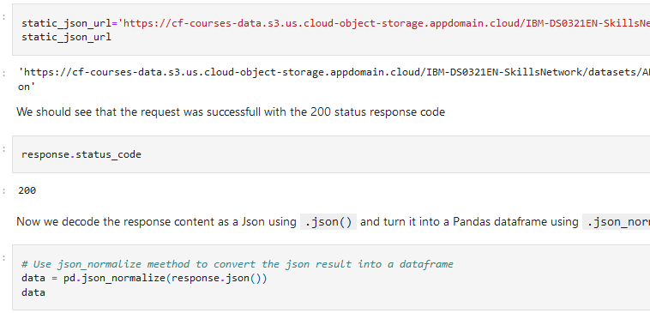
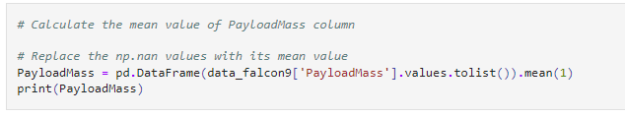
Data Collection
Data was collected via 2 methods: get.request to the SpaceX – API; then,
Decoded the response content as a json() file;
Turned data into a pandas dataframe;
Requested data using GET request; and parse data;
Filtered the data for only Falcon9 data and information;
Dealt with missing values, replacing them with mean values;

Slide 8
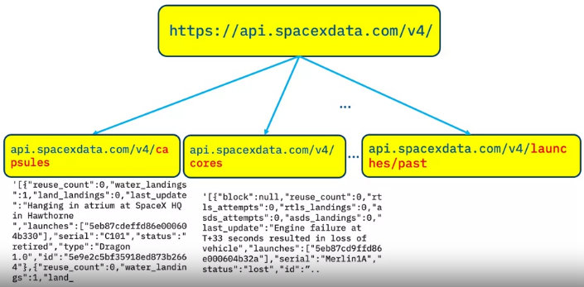
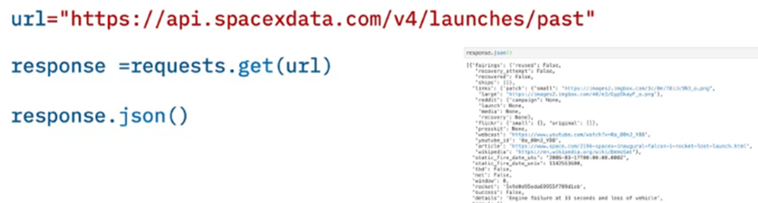
Data Collection – SpaceX API
Data collection with SpaceX API via GET request, filtered data, only for Falcon9 launches and dealt with missing values.
GitHub URL link to the completed SpaceX API calls notebook: https://github.com/JohnWW11/Spacex-falcon9-stage-landing-Pred.-data-collection/blob/main/jupyter-labs-spacex-data-collection-api.ipynb for an external reference and peer-review purpose
Place your flowchart of SpaceX API calls here

Slide 9
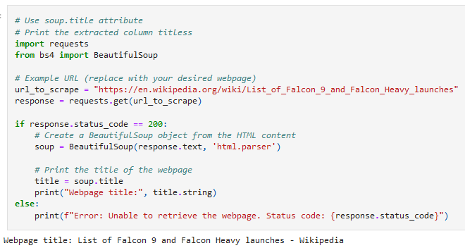
Data Collection - Scraping
Process:
Use of helper functions to process web scraped HTML table
Use of BeautifulSoup for Scraping Falcon9 records data.
Used BeautifulSoup to extract columns variable names from HTML table
GitHub URL of completed web scraped notebook: https://github.com/JohnWW11/Spacex-falcon9-stage-landing-Pred.-data-collection/blob/main/Completed-jupyter-labs-webscraping.ipynb
Place your flowchart of web scraping here

Slide 10
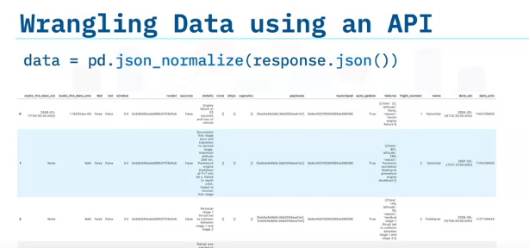
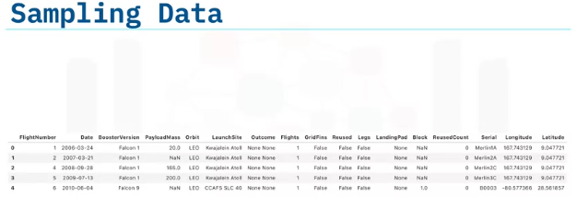
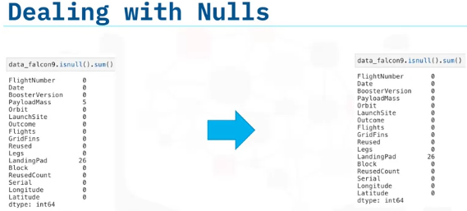
Data Wrangling
How data were processed:
Loaded SpaceX Dataset;
Calculated percentage of missing values;
Calculated the number and occurrences, launches of each site, of each orbit, of mission outcomes, and landing outcomes and exported the results to .csv file.
GitHub URL of completed data wrangling related notebook:
https://github.com/JohnWW11/Spacex-falcon9-stage-landing-Pred.-data-collection/blob/main/Completed-labs-jupyter-spacex-Data%20wrangling.ipynb

Slide 11
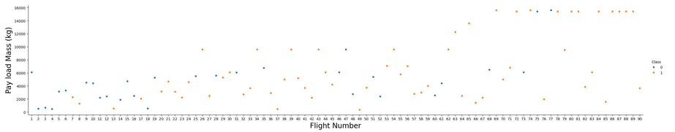
EDA with Data Visualization
Summary of charts plotted and why used those charts:
Flight number and Payload;
Flight number and Launch Site;
Payload and Launch Site;
Success rate of each orbit type and flight number and orbit type.
These were done to see how these variables evolve together and how they affect the launch outcomes.
GitHub URL of your completed EDA with data visualization notebook: https://github.com/JohnWW11/Spacex-falcon9-stage-landing-Pred.-data-collection/blob/main/Completed-jupyter-labs-eda-dataviz.ipynb

Slide 12
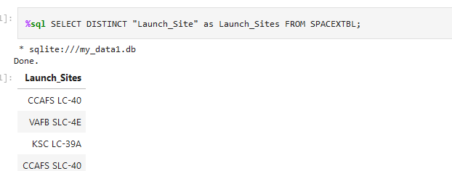
EDA with SQL
Summary of the SQL queries performed:
Names of Unique launch sites;
Average payload mass accrued by booster; ver. F9 v1.1;
Date of first successful landing outcome in ground pad was achieved;
Names of the boosters which have success in drone ship;
List of total number of successful and failure mission outcomes;
List of records which will display the month names, failure landing_outcomes in drone ship
Add the GitHub URL of your completed EDA with SQL notebook: https://github.com/JohnWW11/Spacex-falcon9-stage-landing-Pred.-data-collection/blob/main/Completed-jupyter-labs-eda-sql.ipynb

Slide 13
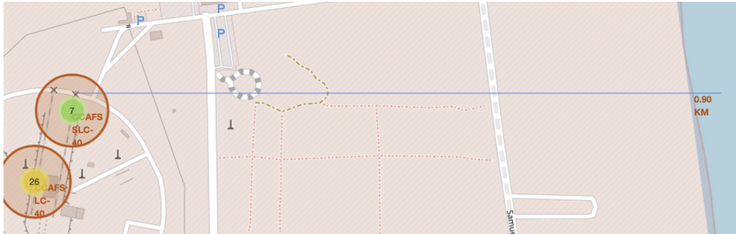
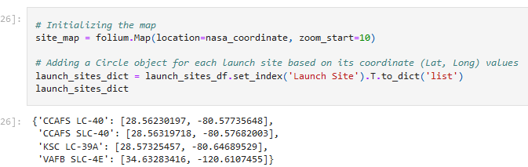
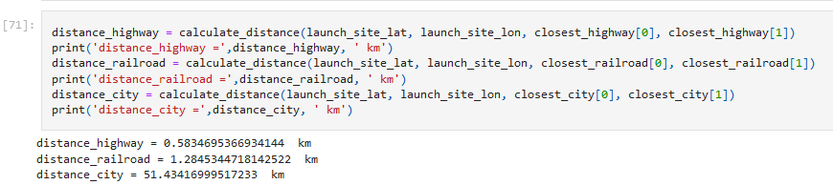
Build an Interactive Map with Folium
Summary of map objects - markers, circles, lines, created and added to a folium map:
Mark all launch sites on a map;
Mark the success/failed launches for each site on the map;
Calculated the distances between a launch site to its proximities;
Objects interactive visual analytics dissemination of information
GitHub URL of your completed interactive map with Folium map: https://github.com/JohnWW11/Spacex-falcon9-stage-landing-Pred.-data-collection/blob/main/Completed-lab_jupyter_launch_site_location.ipynb

Slide 14
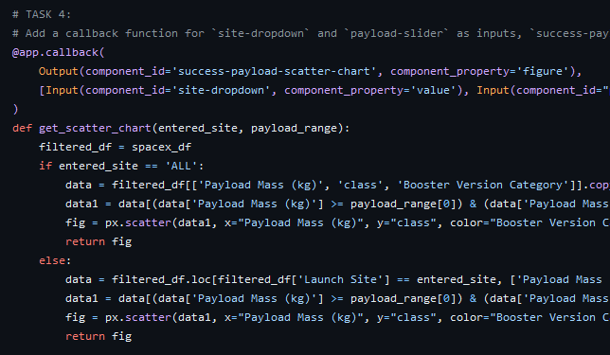
Build a Dashboard with Plotly Dash
Summary of what plots/graphs and interactions codes added to a dashboard:
Dropdown list to enable Launch Site selection;
A pie chart to show the total successful launches count for all sites;
Added a slider to select payload range;
A scatter chart for the correlation between payload and launch success;
Plots and interactions: for easy selections and comparison purposes:
Plots and Charts added to show the relationships of Outcomes with Payload Mass(kg);
GitHub URL of your completed Plotly Dash lab: https://github.com/JohnWW11/Spacex-falcon9-stage-landing-Pred.-data-collection/blob/main/spacex_dash_app.py

Slide 15
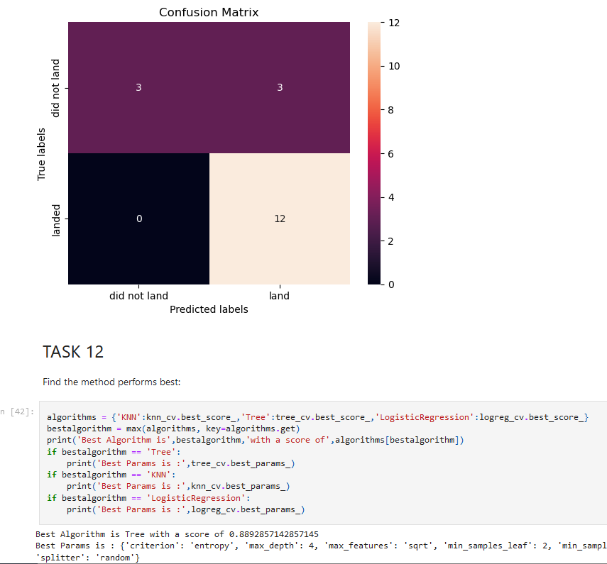
Predictive Analysis (Classification)
Summary of how the classification model was built, evaluated and improved, to find the best performing model:
created a column for the class;
Standardized the data;
Data was split into training data and test data;
Model development process:
Performed exploratory Data Analysis and determine Training Labels;
Built different Machine Learning models;
Found the best Hyperparameter for SVM, Classification Trees and Logistic Regression;
Found the method that performs best using test data;
Add the GitHub URL of your completed predictive analysis: https://github.com/JohnWW11/Spacex-falcon9-stage-landing-Pred.-data-collection/blob/main/Completed-SpaceX_Machine_Learning_Prediction_Part_5.jupyterlite.ipynb

Slide 16
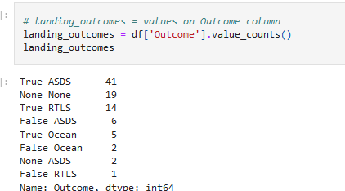
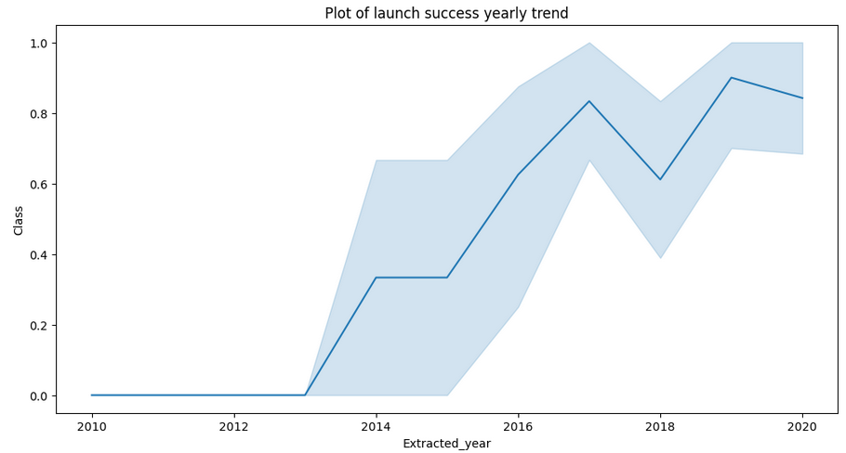
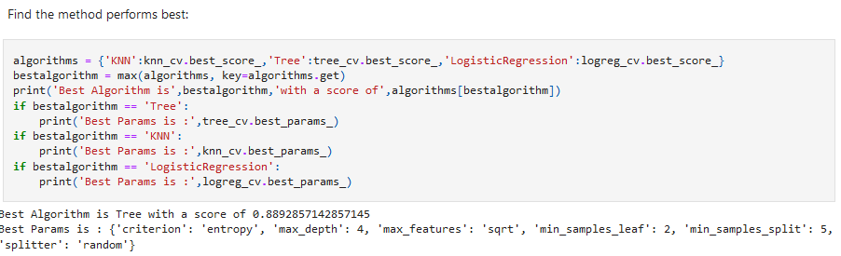
Results
Exploratory data analysis results:
Interactive analytics demo in screenshots:
Predictive analysis results
Best Algorithm is Tree with a score of 0.8892857142857145

Slide 17

Section 2

Slide 18
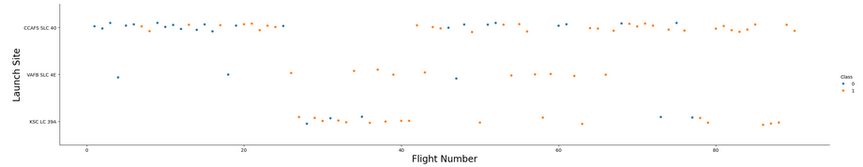
Flight Number vs. Launch Site
Showing a scatter plot of Flight Number vs. Launch Site:
The screenshot of the scatter show that the greater the Flight Number the greater the successes rate.

Slide 19
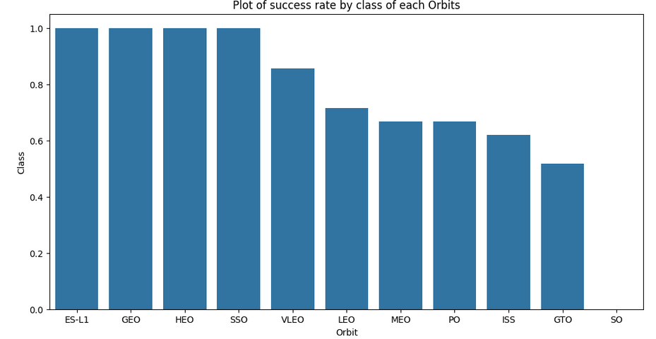
Success Rate vs. Orbit Type
Showing a bar chart for the success rate of each orbit type:
The plot shows that ES-L1, GEO and HEO and SSO had the most success rates with VLEO not too far behind.

Slide 20
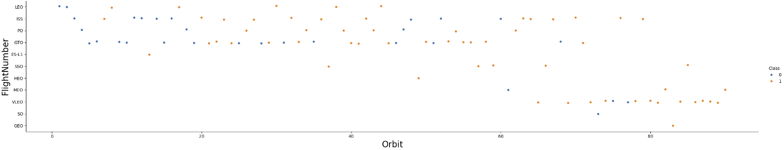
Flight Number vs. Orbit Type
Show a scatter point of Flight number vs. Orbit type:
The plot shows that GTO, PO, ISS, and LEO orbits has the most flights. LEO has the most successful even though there seems to be no relationship between flight number and GTO orbit.

Slide 21
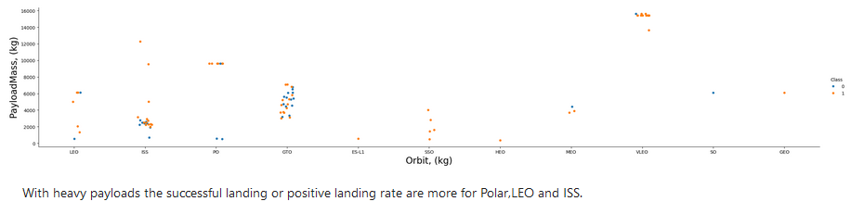
Payload vs. Orbit Type
Showing a scatter point of payload vs. Orbit type:
The plot shows that with heavy payloads the successful landing or positive landing rate are more for PO, LEO, VLEO and ISS.

Slide 22
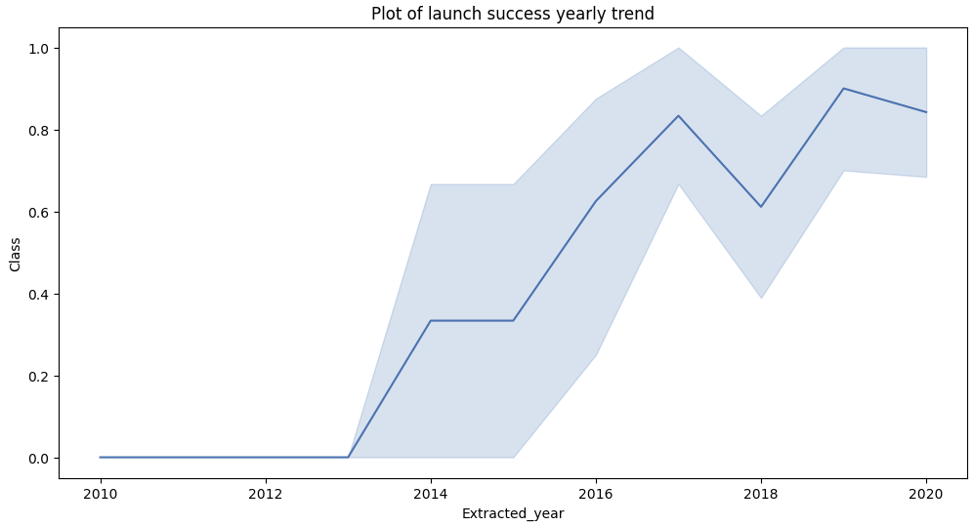
Launch Success Yearly Trend
Showing a line chart of yearly average success rate:
Plot shows launch success yearly trends climbs up from 2013 to 2020, with a slight dip in 2018.

Slide 23
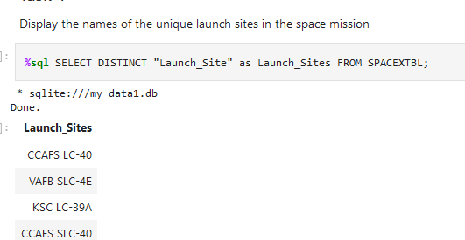
All Launch Site Names
Names of the unique launch sites:
Launch_Sites
CCAFS LC-40
VAFB SLC-4E
KSC LC-39A
CCAFS SLC-40
SQL query result using DISTINCT:
This shows only the unique launch sites from
the SpaceX data.

Slide 24
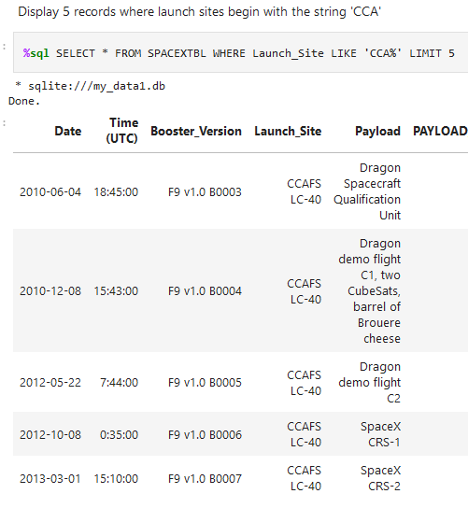
Launch Site Names Begin with 'CCA'
Showing 5 records where launch sites begin with `CCA`:
Showing launch sites with the string “CCA”, using SQL query:
SELECT * FROM SPACEXTBL WHERE Launch_Site LIKE 'CCA%' LIMIT 5

Slide 25
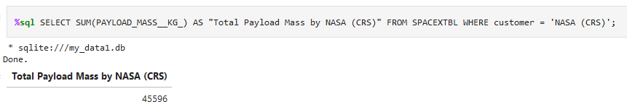
Total Payload Mass
Calculated total payload carried by boosters from NASA:
Showing the results of the total payload by booster from NASA:
45596 kg.

Slide 26
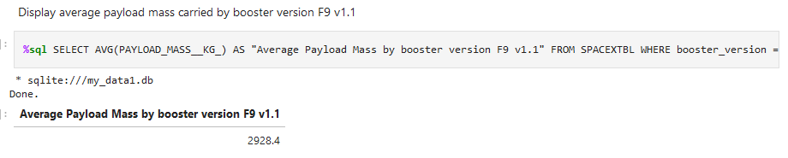
Average Payload Mass by F9 v1.1
Calculated average payload mass carried by booster version F9 v1.1:
Calculated payload mass = 2928.4 kg

Slide 27
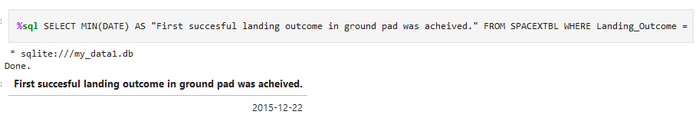
First Successful Ground Landing Date
Find the dates of the first successful landing outcome on ground pad:
Date of first successful landing outcome on ground pas was: 2015-12-22

Slide 28
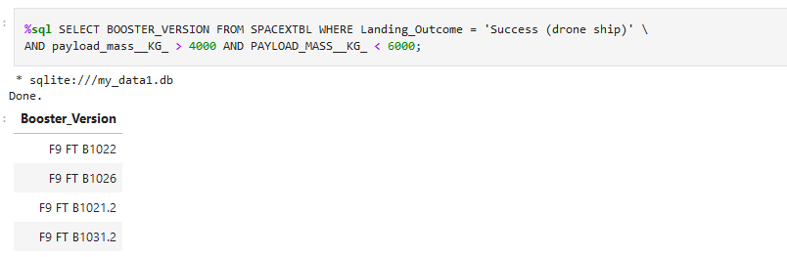
Successful Drone Ship Landing with Payload between 4000 and 6000
Names of boosters which have successfully landed on drone ship and had payload mass greater than 4000 but less than 6000:
Query result of the boosters which have success in drone ship and have payload mass greater than 4000 but less than 6000 – shown above.

Slide 29
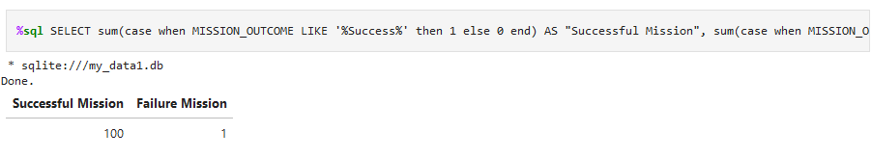
Total Number of Successful and Failure Mission Outcomes
Calculated total number of successful and failure mission outcomes:
Showing results as:
Successful Mission = 100
Failure Mission = 1

Slide 30
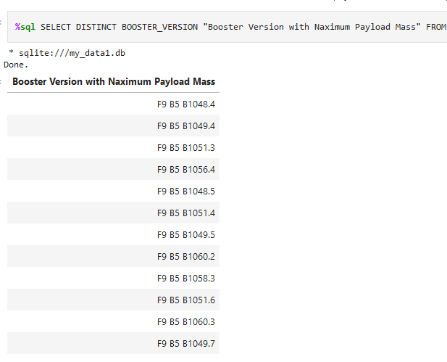
Boosters Carried Maximum Payload
List of the names of the booster which have carried the maximum payload mass:
Presenting query result for 12 Booster Versions with successful Maximum Payload Mass:

Slide 31
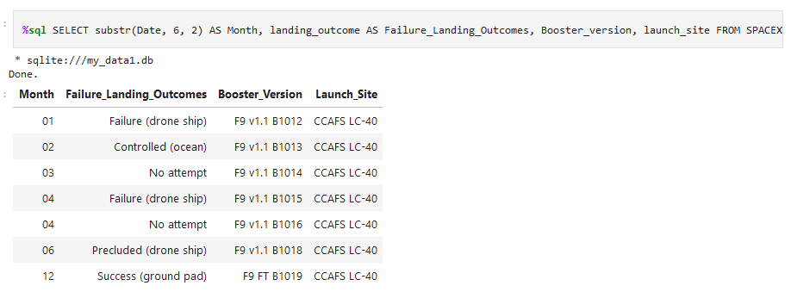
2015 Launch Records
List of failed landing_outcomes in drone ship, their booster versions, and launch site names for in year 2015:
Results of failed landing_outcomes in drone ship, their booster versions, and launch site names for in year 2015, as shown above.

Slide 32
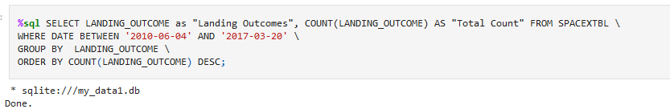
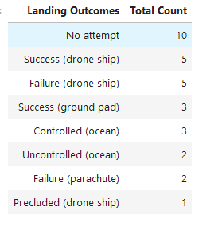
Rank Landing Outcomes Between 2010-06-04 and 2017-03-20
Ranked count of landing outcomes (such as Failure (drone ship) or Success (ground pad)) between the date 2010-06-04 and 2017-03-20, in descending order:
Query result in descending order:
“No Attempt” having 10, with Success and Failure having
equal total counts of 5 each.

Slide 33

Section 3

Slide 34
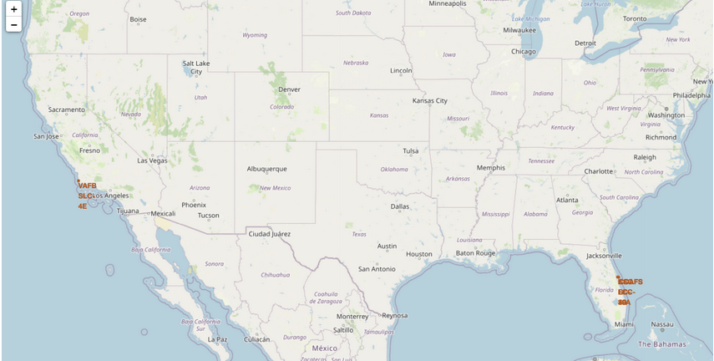
<Folium Map – Marked Launch Sites>
Replaced title with an appropriate title: Folium Map – Marked Launch Sites
Generated folium map: screenshot includes all launch sites’ location markers on a global map
Folium Map showing launch sites proximity to the equator and very close to proximity to the coast of Florida and California.

Slide 35
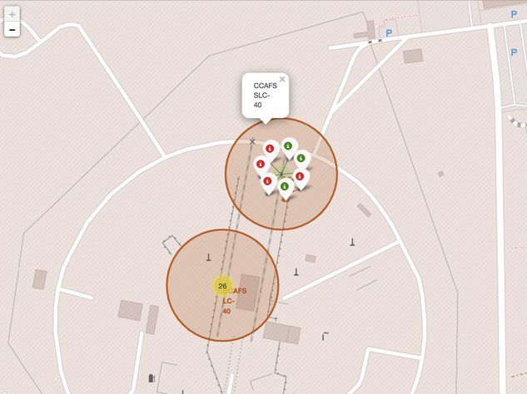
Folium Map: Marked Launch Sites- Color Labelled
Replace title with an appropriate title:
Folium Map – Marked Launch Sites Color Labelled
Folium map with a proper screenshot showing the color-labeled launch outcomes on the map
Color-labelled for easy identification of which launch sites have relatively high success rates:
Green Successful Launches,
Red – Failure Launches

Slide 36
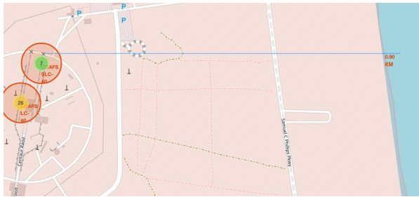
Folium Map: Marked Launch Sites-Calculated Proximity Distance
Replaced Folium map screenshot title with an appropriate title:
Folium Map: Marked Launch Sites – Calculated Proximity Distance
Generated folium map and show the screenshot of a selected launch site to its proximities such as railway, highway, coastline, with distance calculated and displayed
Showing calculated proximity distance of 0.9km

Slide 37

Section 4

Slide 38
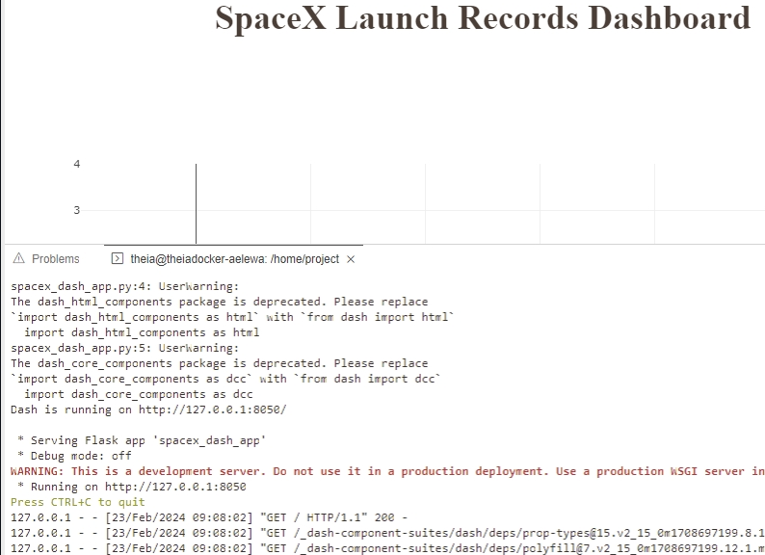
Plotly Dashboard: Plotly Dash
Replaced title with an appropriate title:
Plotly Dashboard: Launch Success Count All Sites
Showing application interface “Cloud IDE refused to generate full diagram due to “busy port: 8050”
Link to screenshot: https://github.com/JohnWW11/Spacex-falcon9-stage-landing-Pred.-data-collection/blob/main/Dasbard-Render.jpg

Slide 39
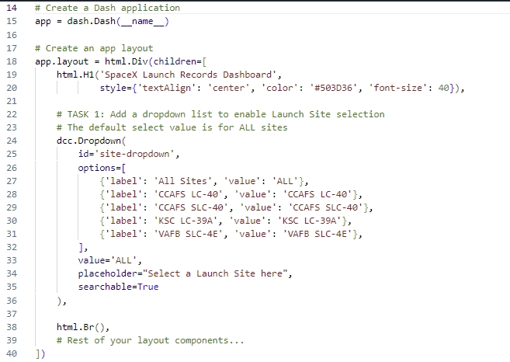
Plotly Dashboard: Launch Success Count – All Sites
Replaced title with an appropriate title:
Plotly Dashboard: Launch Success Count All Sites
Showing application code screenshot of launch success count for all sites, for a pie chart: “Cloud IDE refused to generate diagram”
Link to screenshot: https://github.com/JohnWW11/Spacex-falcon9-stage-landing-Pred.-data-collection/blob/main/TASK-1.jpg

Slide 40
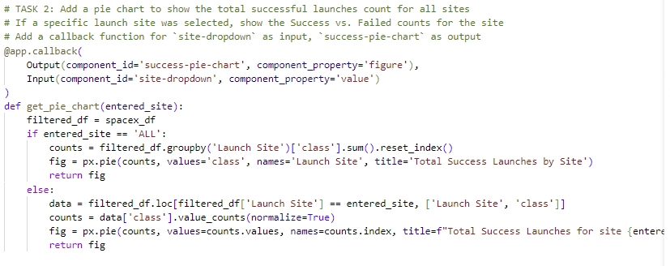
Plotly Dashboard: Launch Site with Highest Success Ratio
Replace title with an appropriate title:
Plotly Dashboard: Launch Site with Highest Success Ratio
Showing the code screenshot of the pie chart code for the launch site with highest launch success ratio
Used callback Input and Output
Used get.piechart and filtered “df” to get the launch site with the highest success ratio.
Link: https://github.com/JohnWW11/Spacex-falcon9-stage-landing-Pred.-data-collection/blob/main/TASK-2.jpg

Slide 41
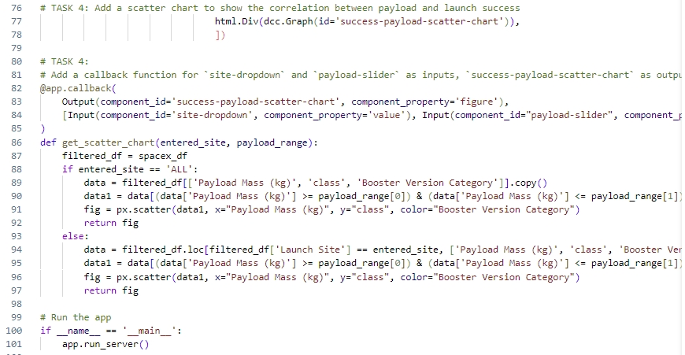
Plotly Dashboard: Payload vs Launch Outcome
Replaced title with an appropriate title:
Plotly Dashboard: Payload vs Launch Outcome
Showing code screenshots of success Payload vs. Launch Outcome scatter plot for all sites, with different payload selected in the range slider
Showing the important code elements and steps for which payload range or booster version have the largest success rate, etc.
Link: https://github.com/JohnWW11/Spacex-falcon9-stage-landing-Pred.-data-collection/blob/main/TASK-4.jpg

Slide 42

Section 5

Slide 43
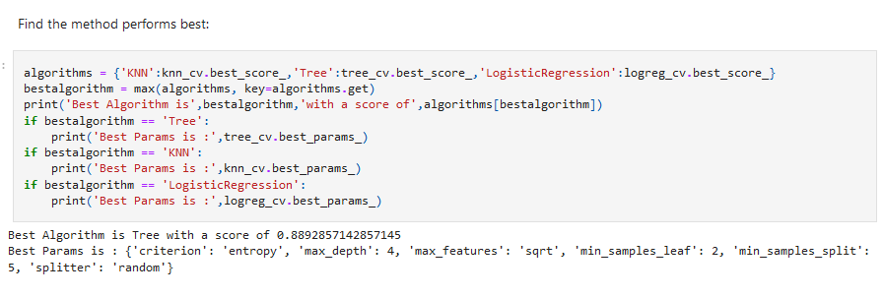
Classification Accuracy
Model showing the highest classification accuracy is the Decision Tree Classifier;
The final score is: 0.8892857142857145

Slide 44
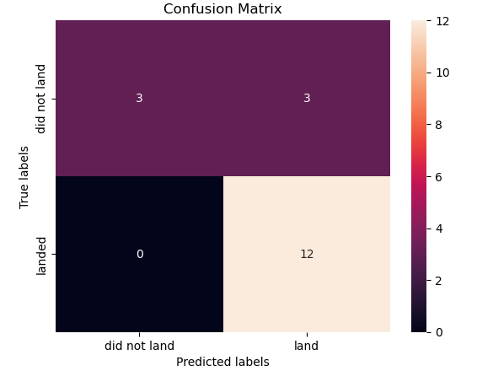
Confusion Matrix – Best Performing Model
Showing the confusion matrix of the best performing model: –
From the Decision Tree Classifier
Showing the notable differences between the different classes. However False Positive exists for cases where unsuccessful landing were marked as successful.

Slide 45
Conclusions
We can successfully conclude that:
Point 1 - Larger flight amount seems to correspond with greater success rate;
Point 2 – Orbit success rates corresponds with ES-L1, GEO, HEO, SSO, VLEO;
Point 3 – The most successful launch site is KSC LC-39A of all other sites;
Point 4 – The Decision Tree Classifier model work best in all of the models developed;
Point 5 – Proximity to the equator and the ocean provides easier access for operational tasks;

Slide 46
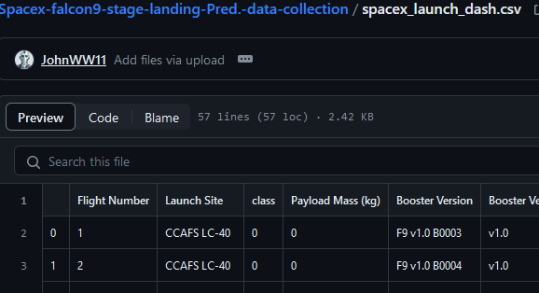
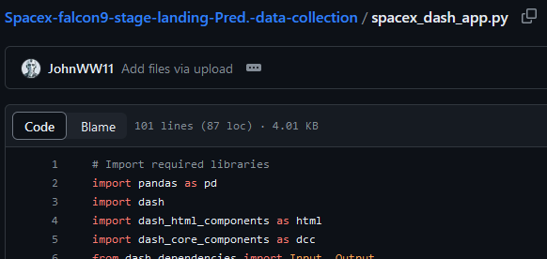
Appendix
SpaceX Launch Dash csv:
Github link: https://github.com/JohnWW11/Spacex-falcon9-stage-landing-Pred.-data-collection/blob/main/spacex_launch_dash.csv
SpaceX Launch Dash code snippet:
Github link: https://github.com/JohnWW11/Spacex-falcon9-stage-landing-Pred.-data-collection/blob/main/spacex_dash_app.py

Slide 47


